Slide 1
NXT Kit Overview
U1C3

Slide 2
1.3.2 NXT Kit Overview
Lesson: NXT Kit Overview
Overview: The goal of this lesson is to give students a hands-on experience with the NXT components as they begin to understand, identify and categorize this large assortment of parts.
Objectives:
Students will be able to:
1. Identify, Organize and Catalog NXT Kit contents
2. Explain why maintaining the robotics kit organization is important

Slide 3
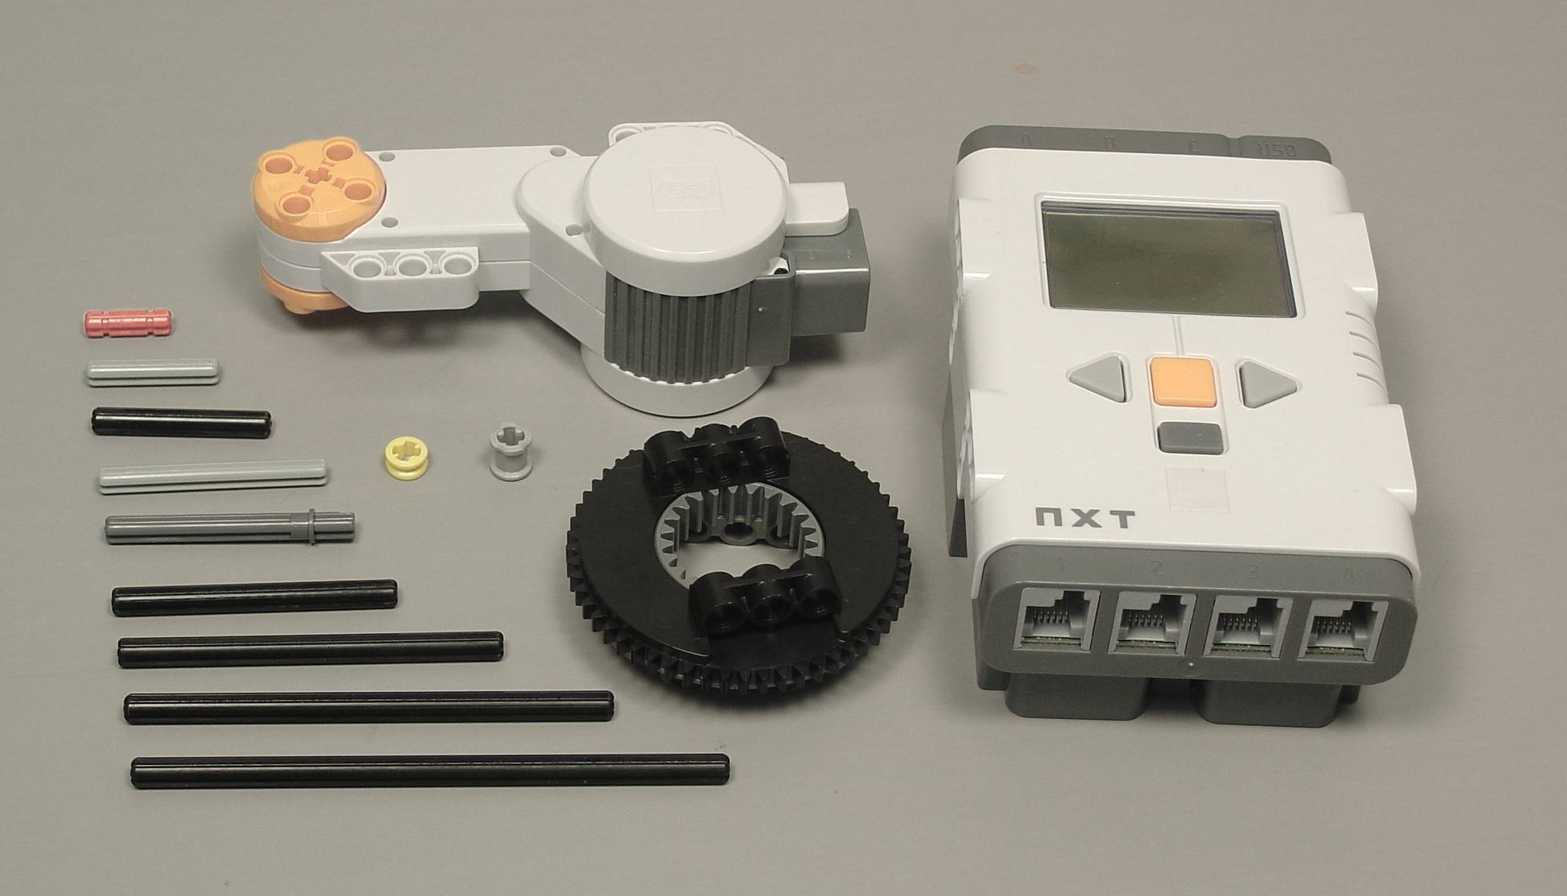
LEGO MINDSTORMS
Education NXT Base Set 9797
Parts Pictures & Names – Hi Res
http://stemrobotics.cs.pdx.edu/sites/default/files/LEGO%20inventory%20pics_2.pdf
Notes:
NXT: Our Robotics Technology of Choice
o Ask how many students have worked with Lego
§ Lego is the "manufacturer" of the NXT (first robot characteristic)
o Explain we will explore hardware vs firmware vs software in future lessons
§ Hardware – what you can touch
§ Software – instructions programmer (student) gives robot
§ Firmware – instructions manufacturer (Lego) gives robot
o We’ll be focusing on the hardware for the next few lessons

Slide 4
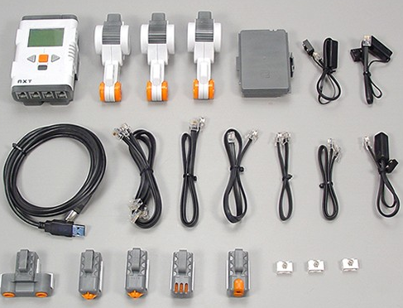
LEGO MINDSTORMS
Education NXT Base Set 9797
Parts Identification
A
C
B
D
E
F
G
H
I
J
K
http://stemrobotics.cs.pdx.edu/sites/default/files/parts.swf
Notes:
NXT: Our Robotics Technology of Choice
o Ask how many students have worked with Lego
§ Lego is the "manufacturer" of the NXT (first robot characteristic)
o Explain we will explore hardware vs firmware vs software in future lessons
§ Hardware – what you can touch
§ Software – instructions programmer (student) gives robot
§ Firmware – instructions manufacturer (Lego) gives robot
o We’ll be focusing on the hardware for the next few lessons

Slide 5
Its creator calls this machine the Lego Great Ball Contraption. Built in his house by Lego genius Akiyuki over the course of two years, for a total of 600 hours of construction time, the machine has staggering dimensions: 17 modules that process 500 balls for a length of 101.7 feet (31 meters) at a rate of one ball per second. The total size is 5 by 21 feet (1.5 meters by 6.5 meters).
The Most Insane Lego Ball Machine
http://gizmodo.com/5944472/the-most-insane-lego-machine-ive-ever-seen
Notes:
NXT: Our Robotics Technology of Choice
o Ask how many students have worked with Lego
§ Lego is the "manufacturer" of the NXT (first robot characteristic)
o Explain we will explore hardware vs firmware vs software in future lessons
§ Hardware – what you can touch
§ Software – instructions programmer (student) gives robot
§ Firmware – instructions manufacturer (Lego) gives robot
o We’ll be focusing on the hardware for the next few lessons

Slide 6
NXT Kit Overview
The Most Insane Lego Ball Machine (0:00)
http://gizmodo.com/5944472/the-most-insane-lego-machine-ive-ever-seen
Notes:
o NXT – Although Lego, not just a toy
§ Show video examples of Rubik’s Cube Solver, Sudoku Solver and Portrait drawing NXT
· Exact same hardware as students will use in class
· Point out brick, motors and sensors in videos
· More complex software than students will start with, but all within reach in advanced classes

